Slide 1
Sustainability Advocates Programme 2024-2025

Slide 2
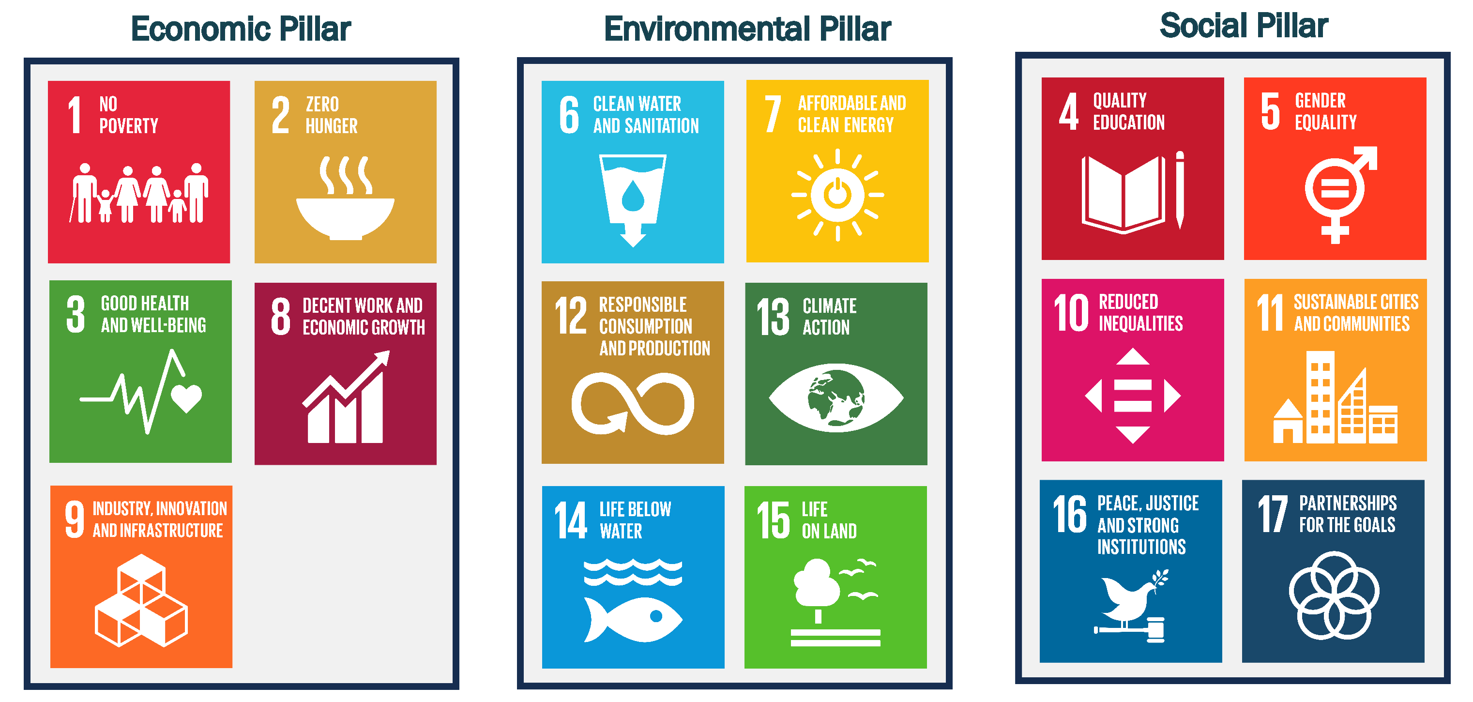
UN Sustainable Development Goals

Slide 3
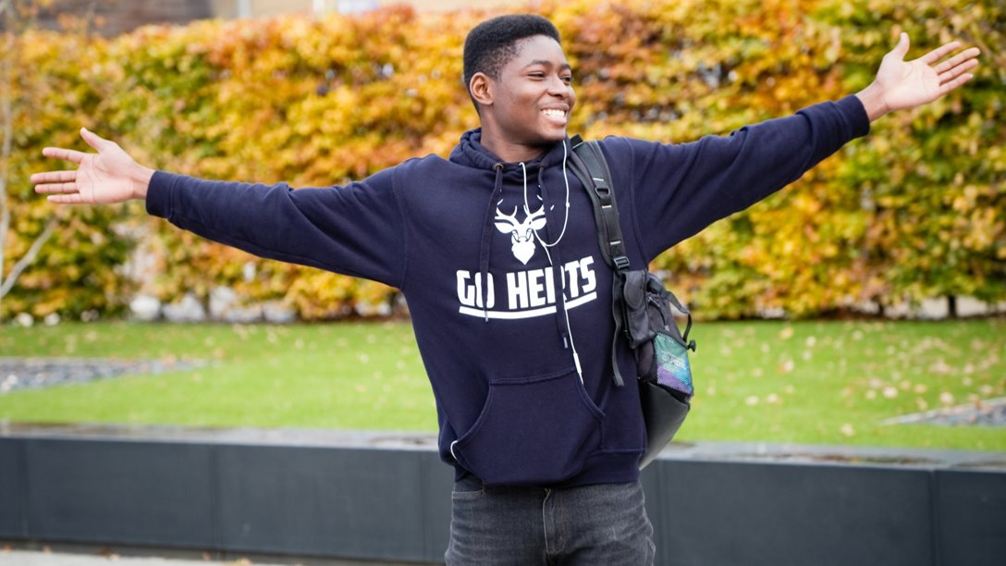
Become a Sustainability Advocate

Slide 4
Sustainability Advocates
Aims of the programme
Enrichment
Enrichment
Empowerment
Recognition
Learn outside of your course and gain practical work experience.
Make a real difference to sustainability issues at Herts.
Recognition for your CV by taking part and reflecting on your learning.
To receive official recognition, you must complete at least 5 hours of volunteering with us including one 'Enrichment' and one 'Empowerment' activity

Slide 5
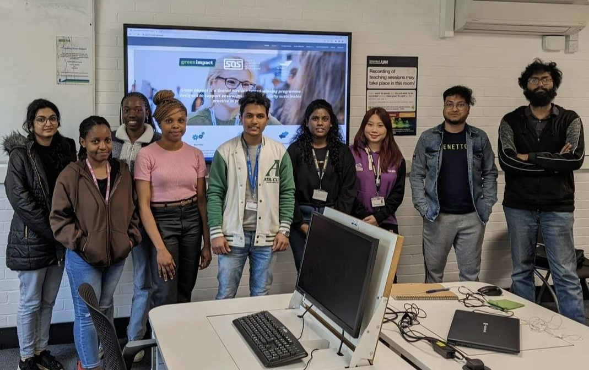
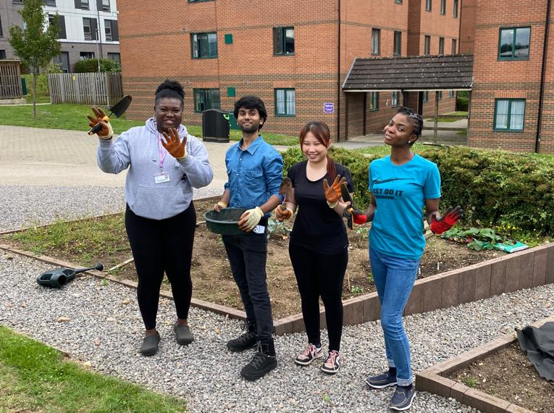
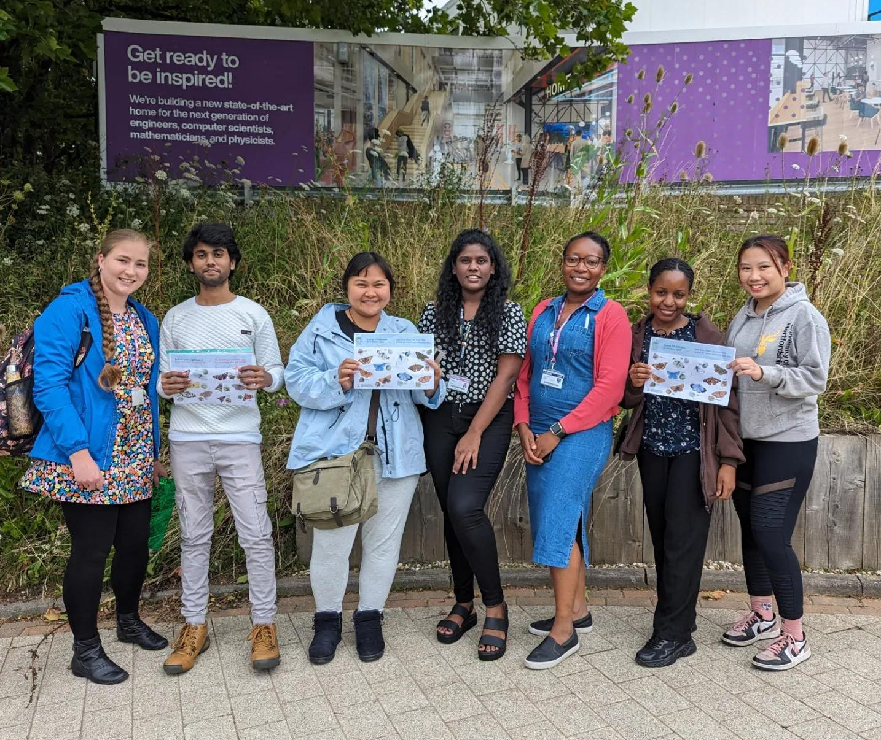
Student Enrichment
Aim: To provide students with opportunities to learn outside of their course and gain practical employability skills
Creating a link between sustainability best practice and the transferable skills that you will use in your professional career
For official recognition, you must:
Attend at least one training session throughout the academic year
  Environmental audit training
  Wildlife survey training
  Allotment sessions
  Sustainability workshop/talk

Slide 6
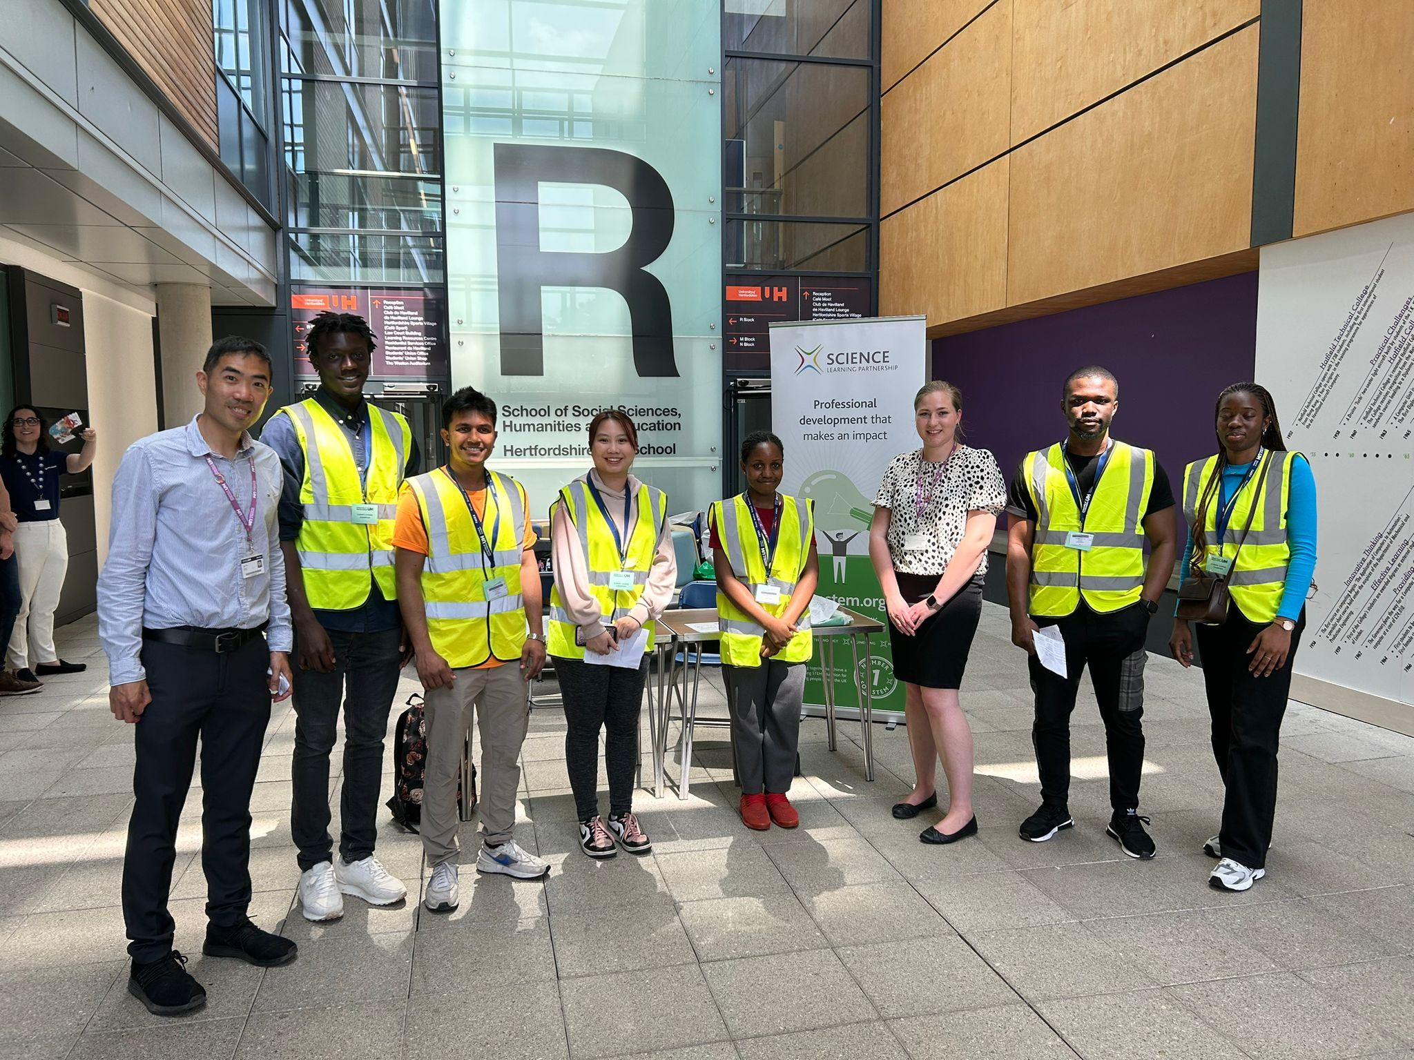
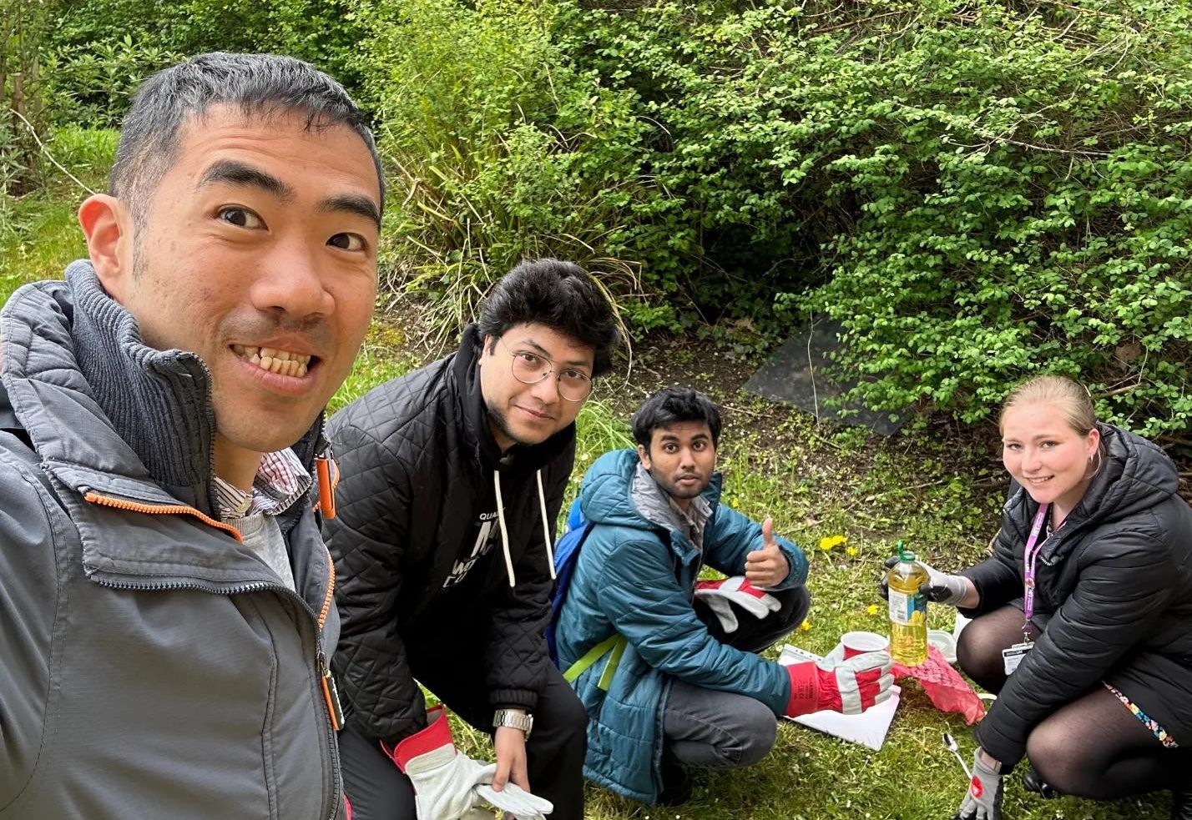
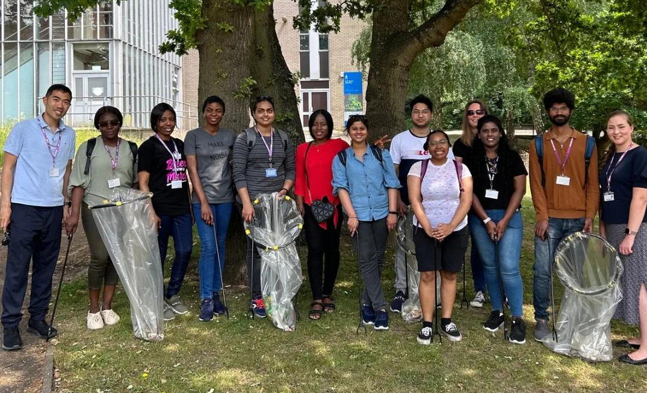
Student Empowerment
Aim: To provide students with the opportunity to make a difference to social and environmental sustainability at the University
For official recognition, you must:
Participate in at least one of the pre-organised activities including:
  Green Teams audits
  Recycling audits
  Energy audits
  Wildlife surveys
  Litter picks
  Community outreach
  Assisting with awareness stalls
Go one step further: Organise and run your own events/campaigns

Slide 7
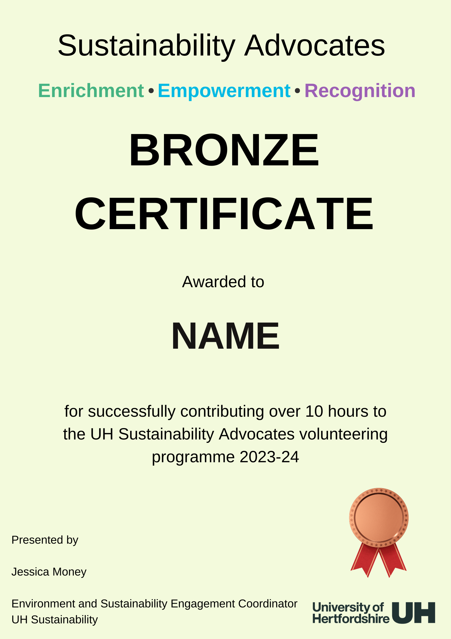
Student Recognition
Aim: To provide students with the opportunity to get recognition for the extra-curricular Sustainability Driven activities they participate in.
Award Levels
Certificate of Participation: Volunteer over 5 hours
Bronze Certificate: Volunteer 10-20 hours
Silver Certificate: Volunteer 20-40 hours
Gold Certificate: Volunteer 40-60 hours
Diamond Certificate: Volunteer 60-80 hours
Platinum Certificate: Volunteer 80+ hours

Slide 8
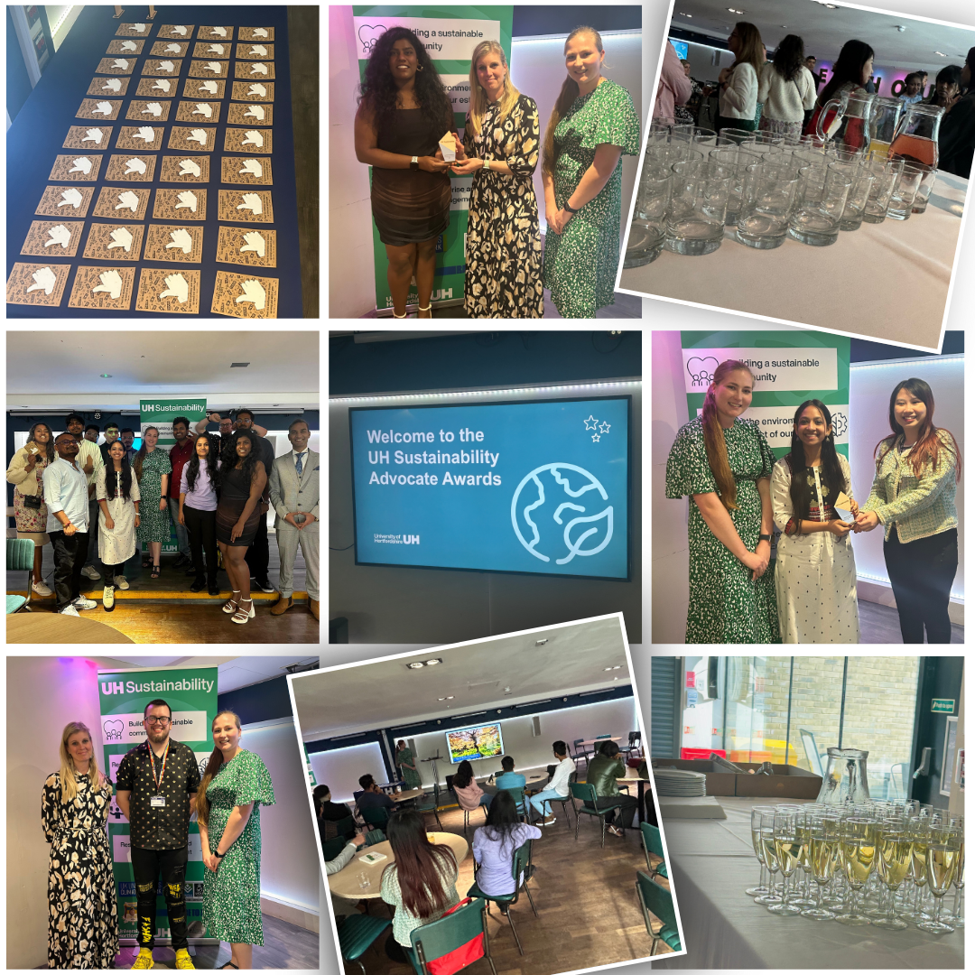
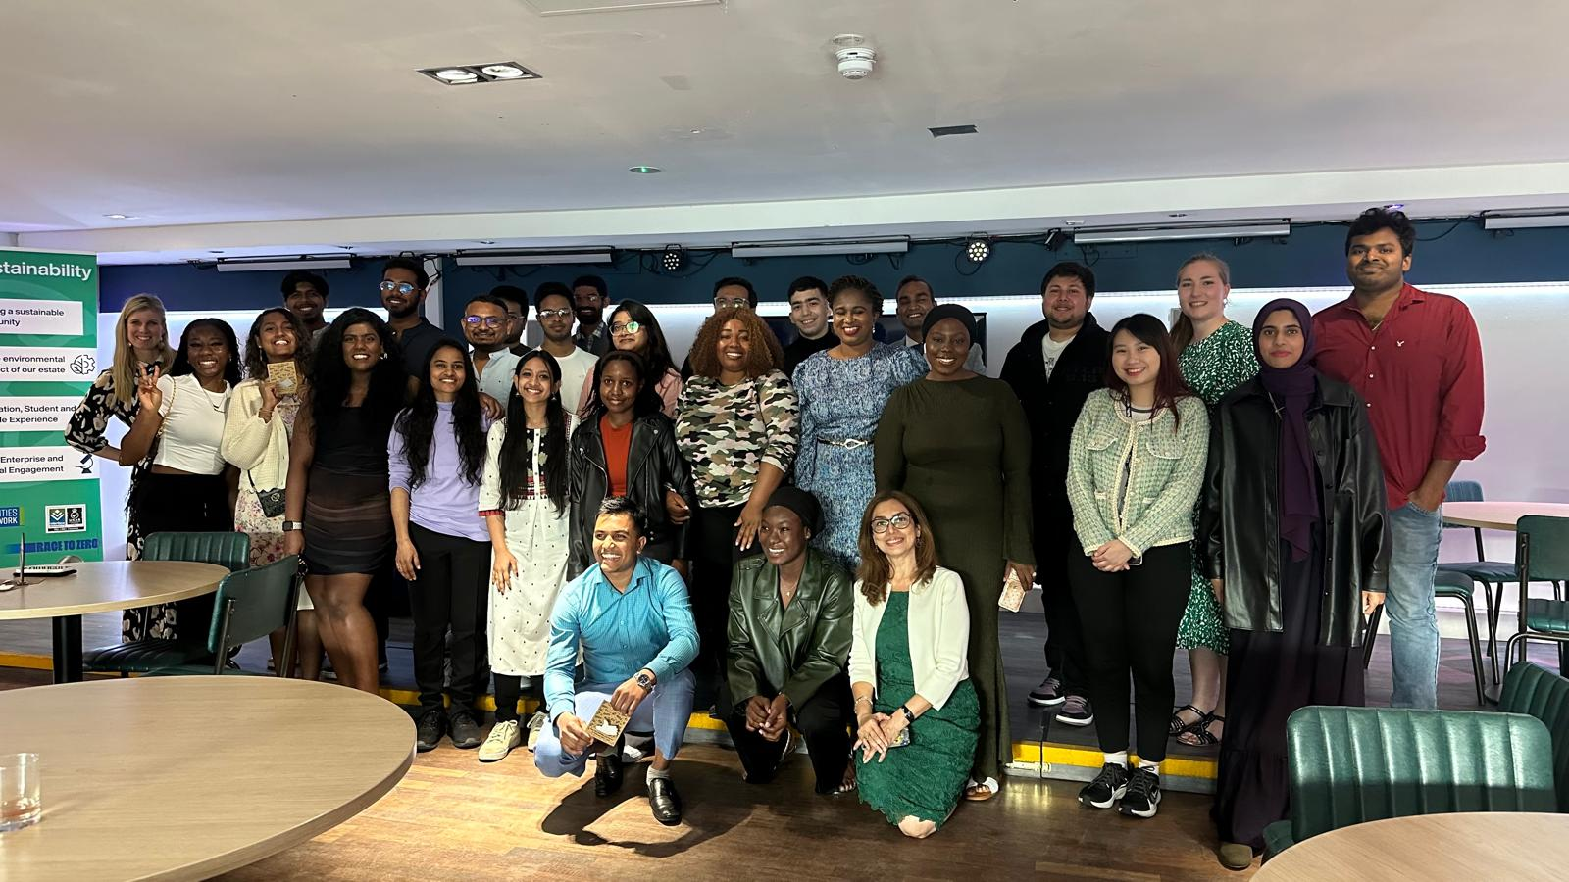

Sustainability Advocate Awards 2024
Certificate of Participation: 20
Bronze Certificate: 20
Silver Certificate: 15
Gold Certificate: 4
Diamond Certificate: 1
Platinum Certificate: 3

Slide 9
Programme Schedule
We will email you about upcoming events and details will also be on our social media.
Month | Events/Activities
October | Unblocktober, Big Hog Friendly Litter Pick Challenge
November | Energy audits, COP29 discussions
December | Sustainable festivities
January | Veganuary, Big Garden Birdwatch
February | Recycling audits, Youth COP
March | Go Green Week, Great British Spring Clean
April | Earth Day, Hedgehog footprint surveys
May | Green Teams audits, Advocate awards
Summer | Sust Fest, KS3 Climate Summit, Big Butterfly Count

Slide 10
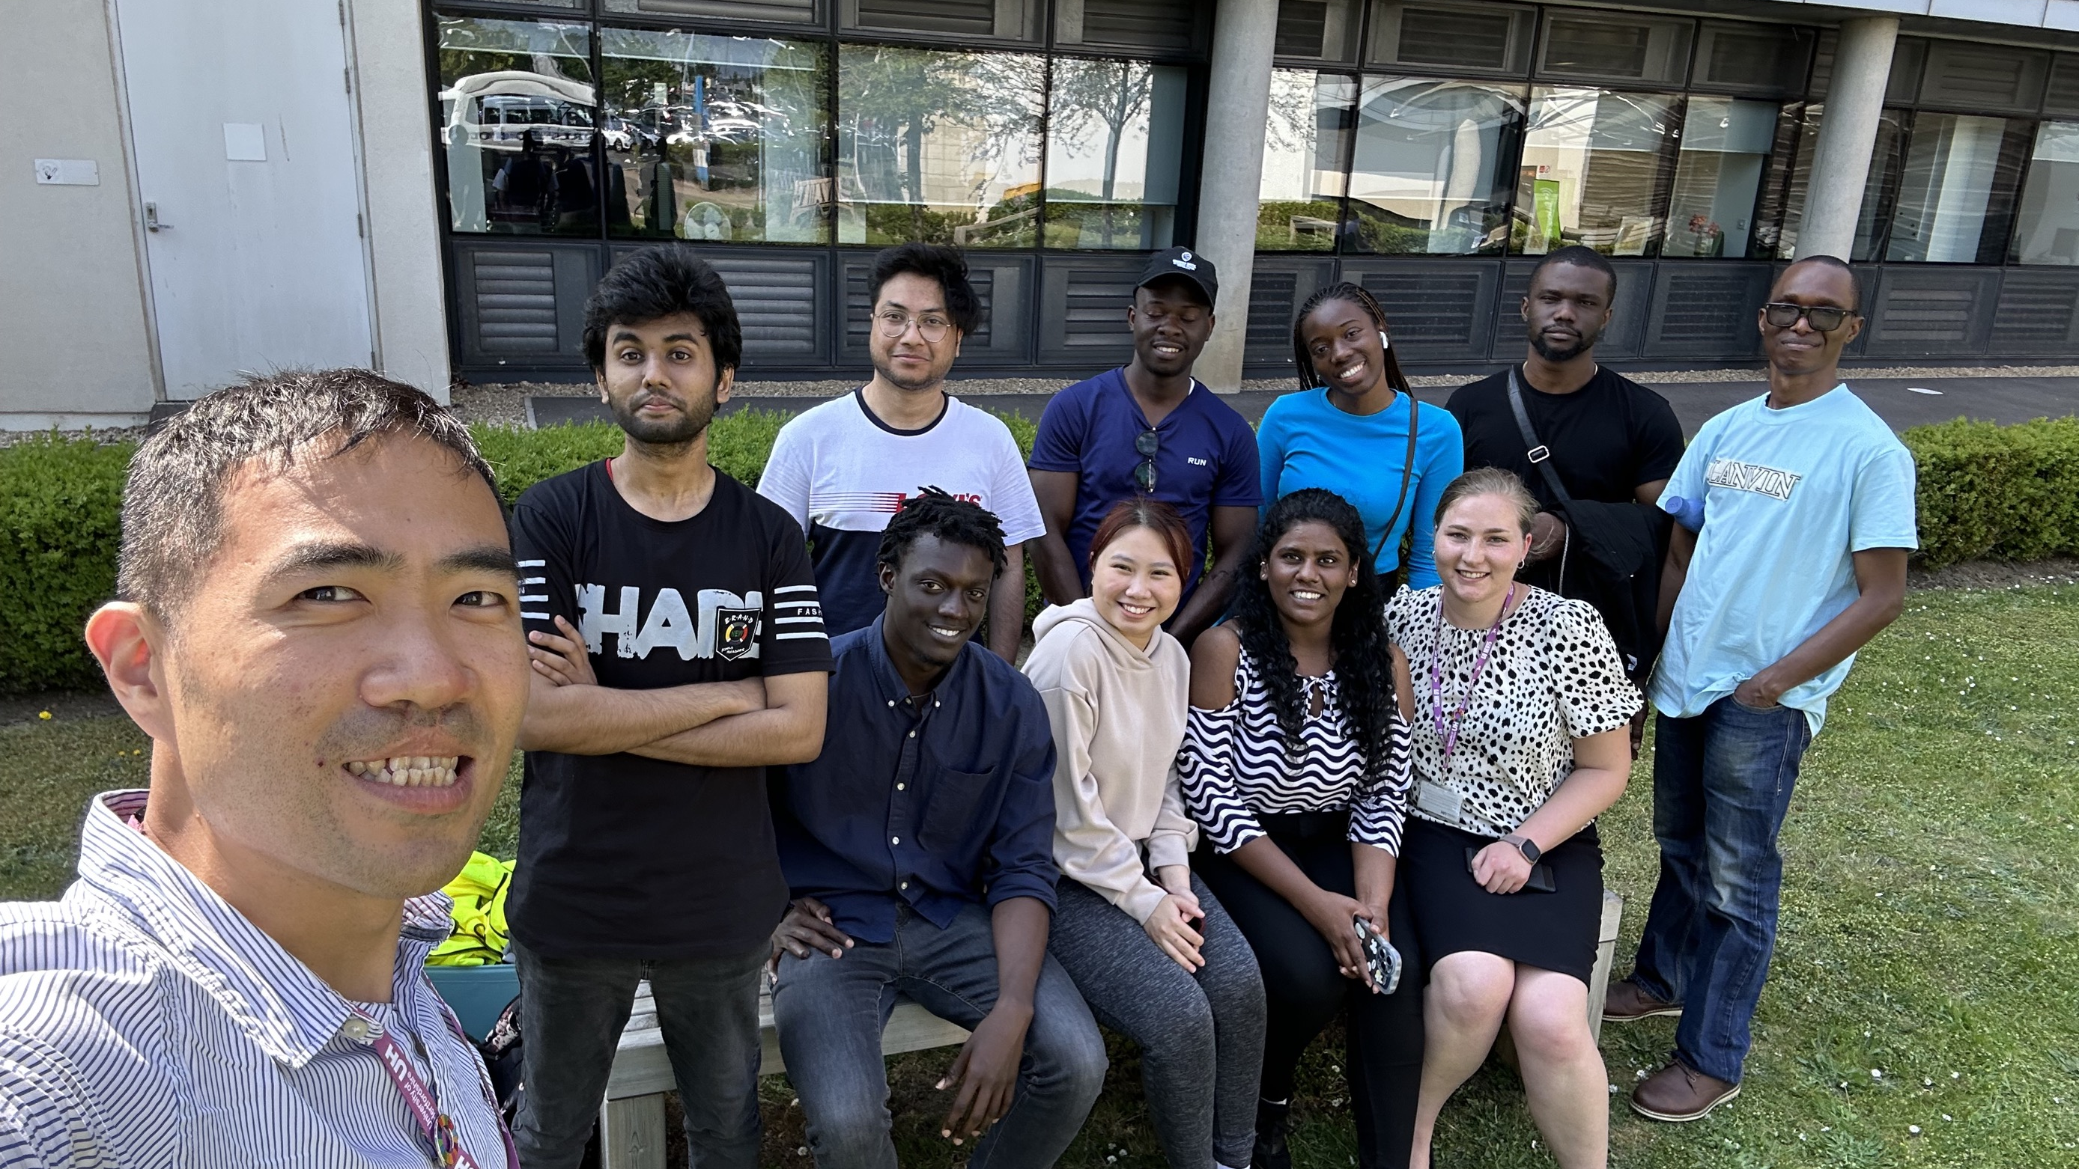
Hear from our previous Sustainability Advocates

Slide 11
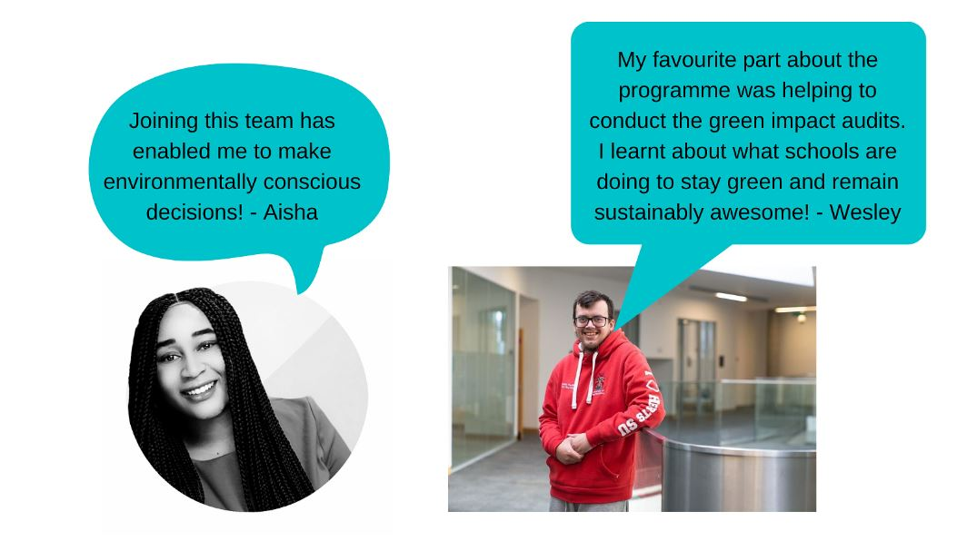

Slide 12


@uhsustainability @uhsustainability
Thank you!
For more information contact sustainable@herts.ac.uk

